Slide 1

Turtle Drawing

Slide 2

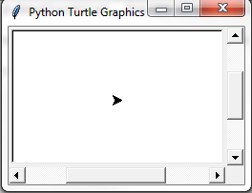

Slide 3

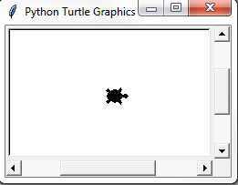
arrow
turtle
circle
square
triangle
classic

Slide 4
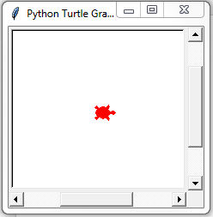
black | pink | gold | purple
cyan | violet | magenta | gray
green | orange | red | yellow
blue | brown | white
http://www.tcl.tk/man/tcl8.5/TkCmd/colors.htm

Slide 5
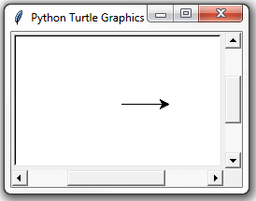
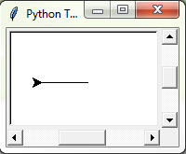


Slide 7
90
left( )
0
right( )
90

Slide 8
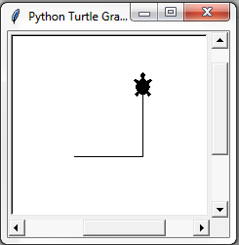


Make a square!

Slide 9
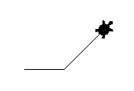
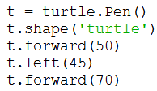

Slide 10
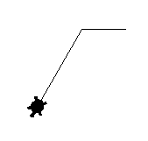
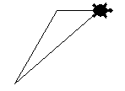
turtle.home()

Slide 11
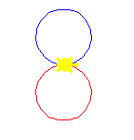
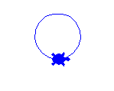
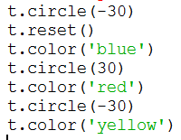


Slide 12



Slide 13



turtle.stamp()
turtle.clearstamp(stampid)

Slide 14
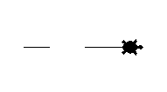

Slide 15

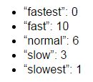


Slide 16

Try to display 2 turtles in a vertical line.

Slide 17
import random
x = random.randint(a,b)
Returns a random number N such that:
a <= N <= b

